Slide 1

Craft Breweries in the US
By: Rolly Costillas

Slide 2
Introduction
Visualization
Interactive Mapping of craft breweries in the US by city showing the following: Brewery Name, Beer Name, Beer Style, and the Overall Review.
Datasets
Kaggle-Beer Reviews
BeerAdvocate Web Scape
HTML / JavaScript / CSS

Slide 3
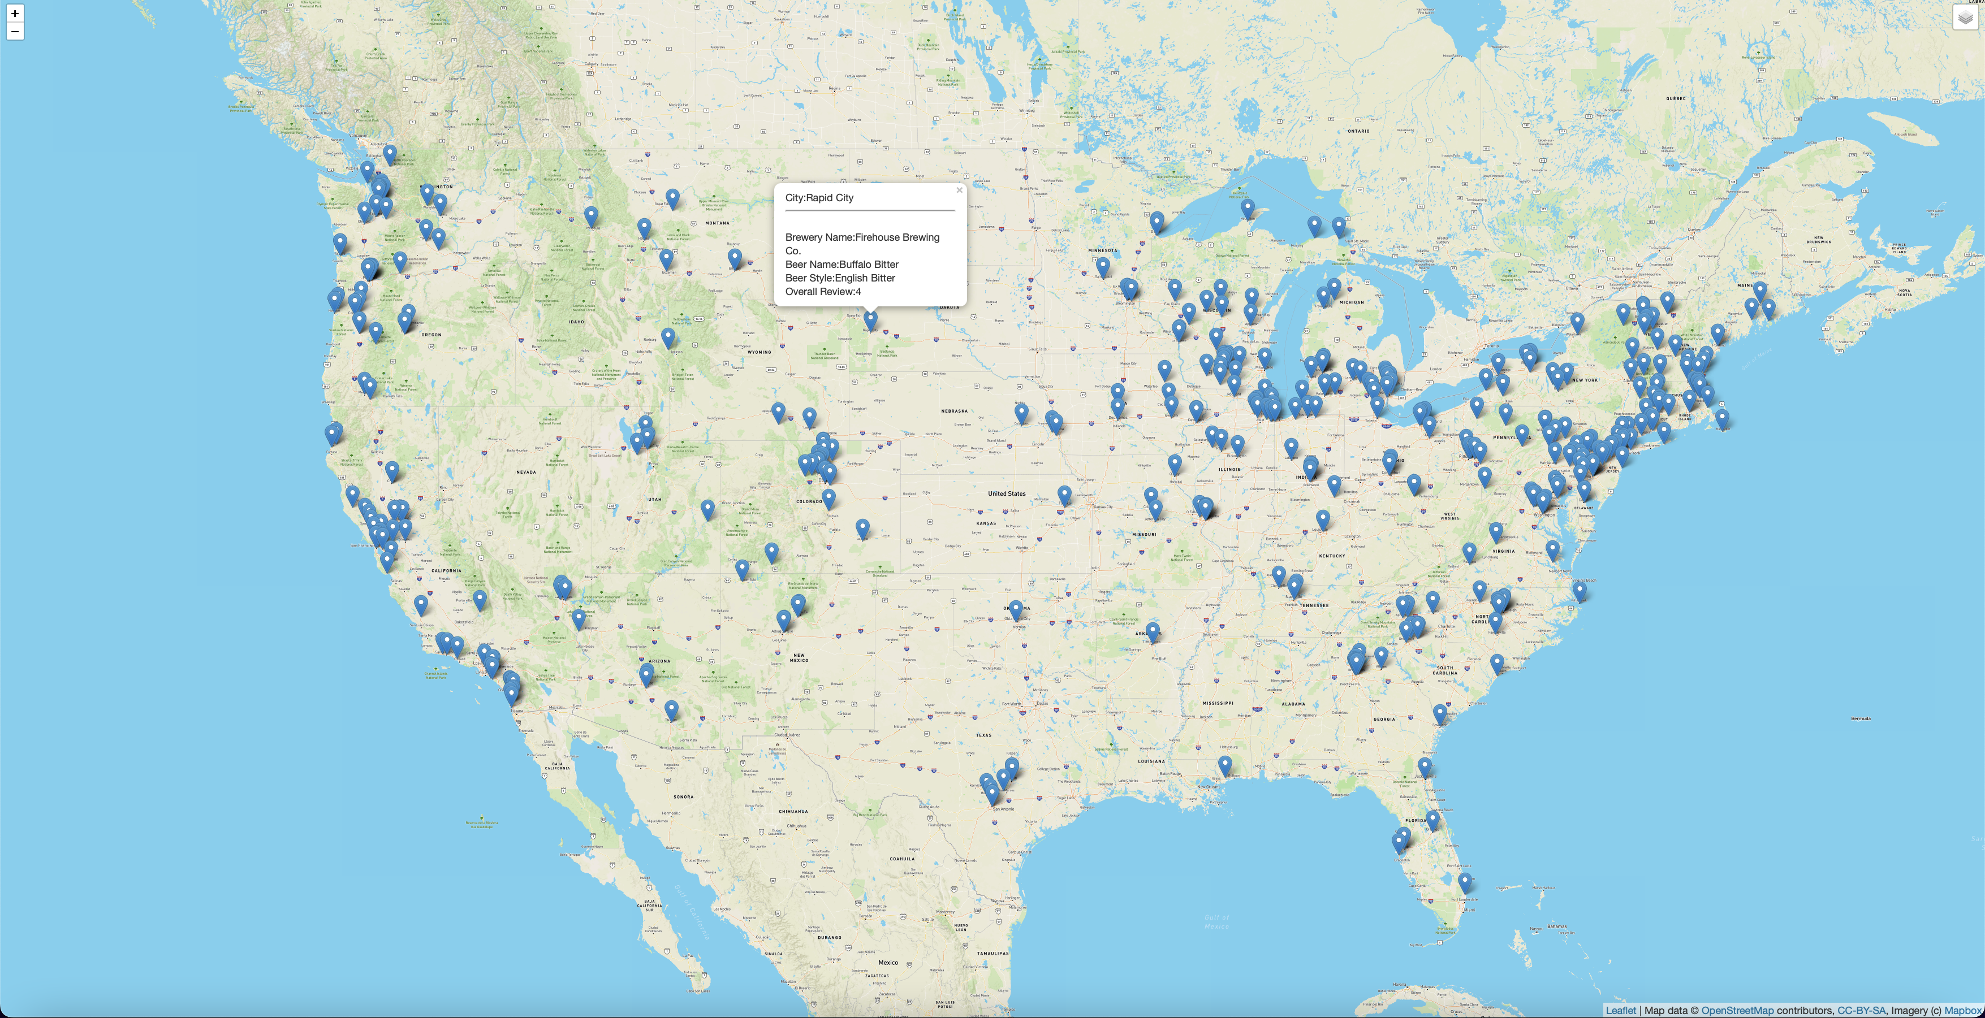
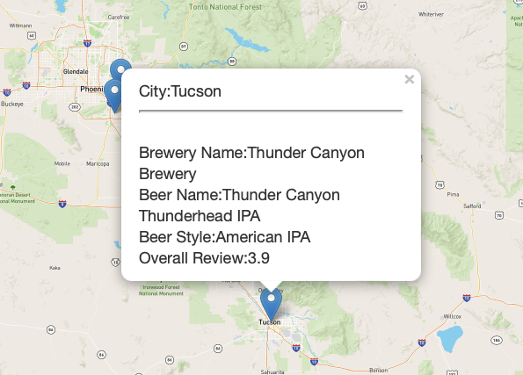
Interactive Map of Craft Breweries in the US
The Street View Map

Slide 4
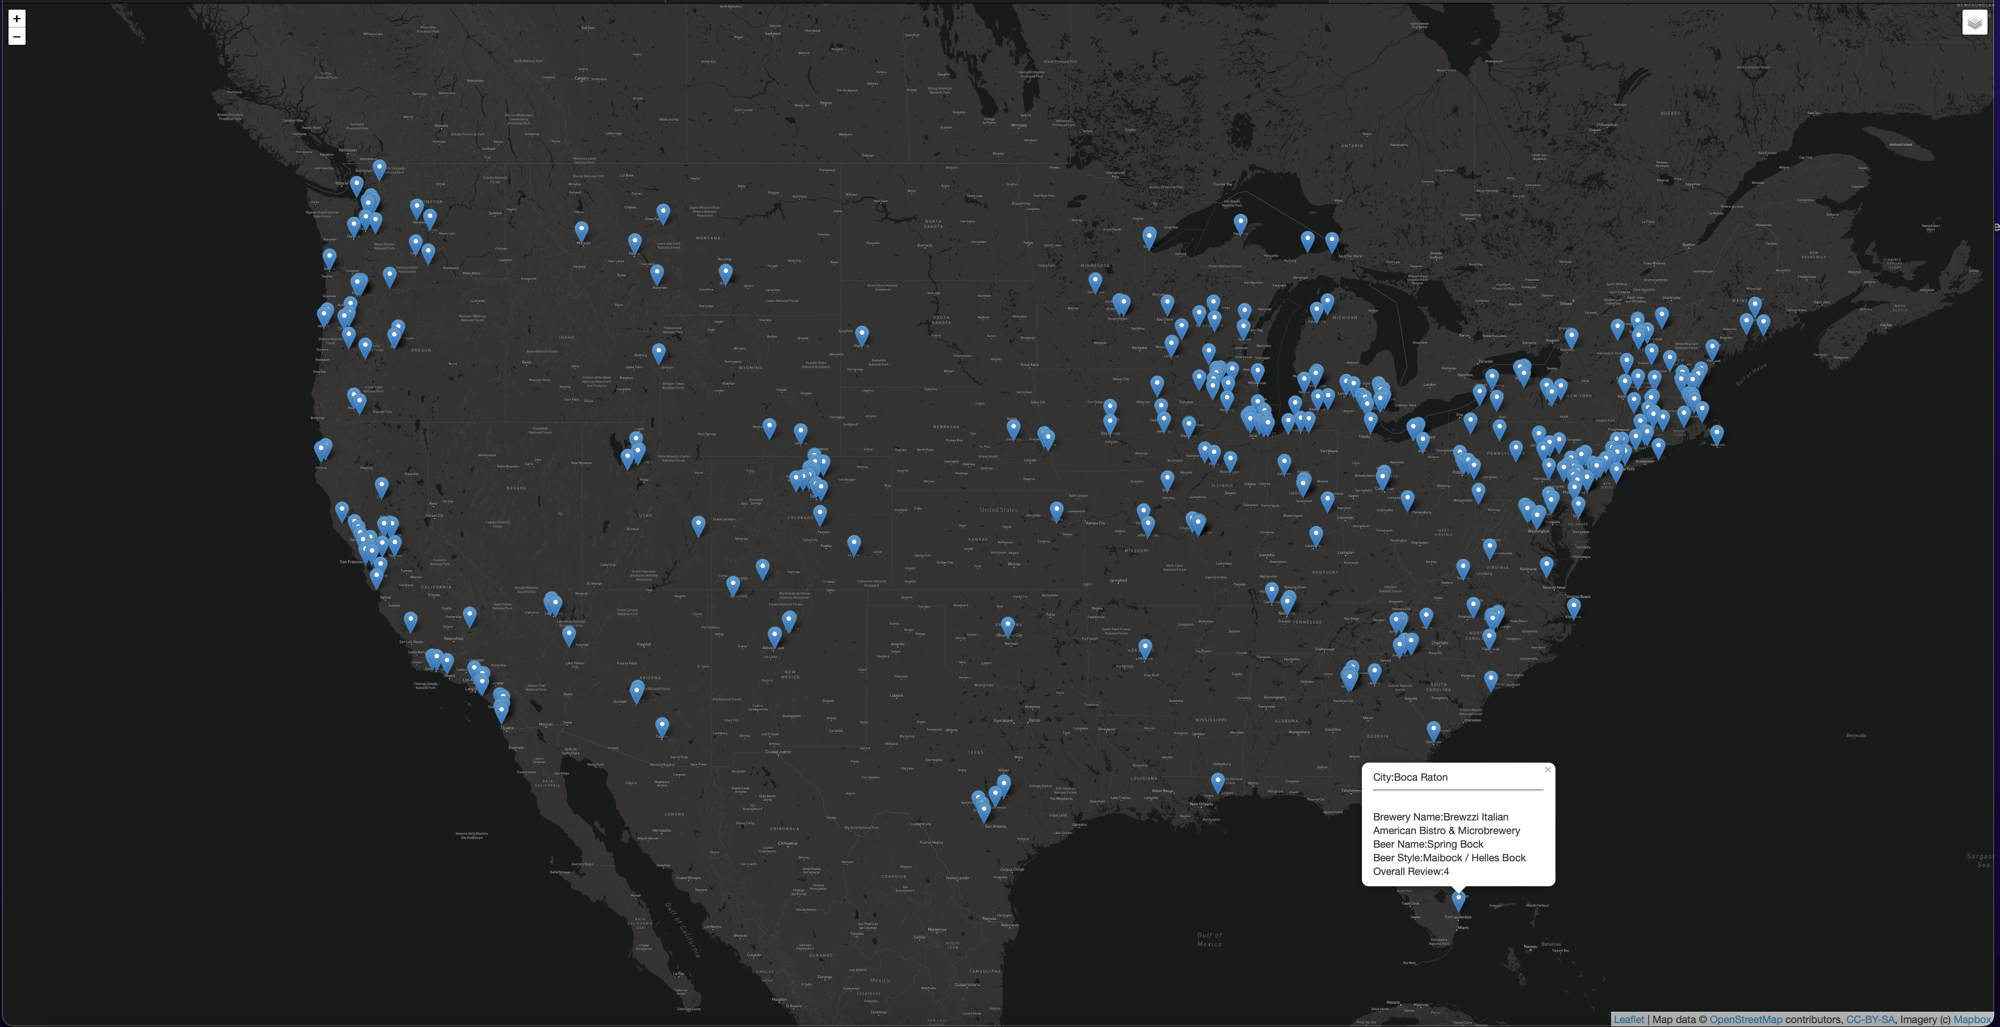
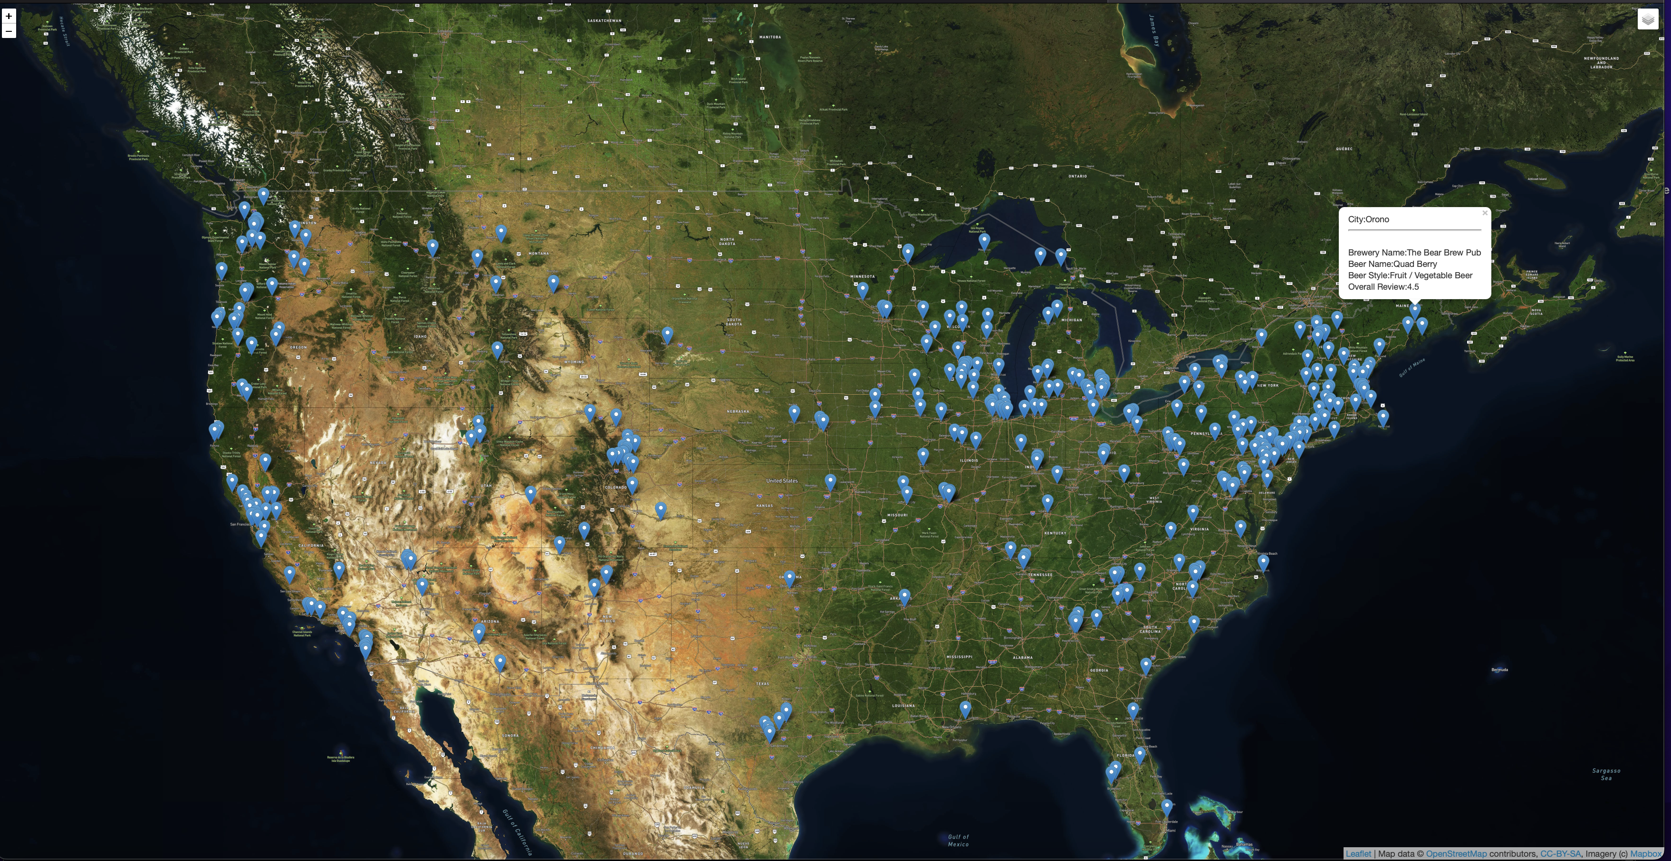
Satellite View
Dark View

Slide 5
End of Presentation.
Thank you!

